Slide 1
Traffic Management Experiment
Steven Lai

Slide 2
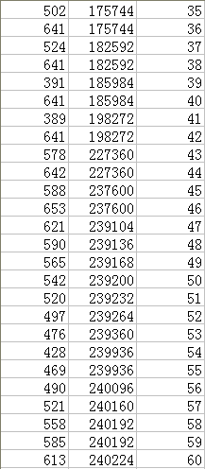
The Raw Data
Because the limit of storage space on the mote, data is recorded only when there is a ‘big’ change of the sensory data.
Fields: data reading, timestamp, sequence.

Slide 3
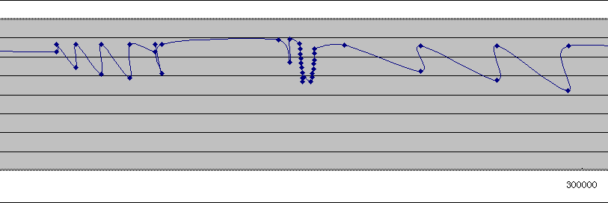
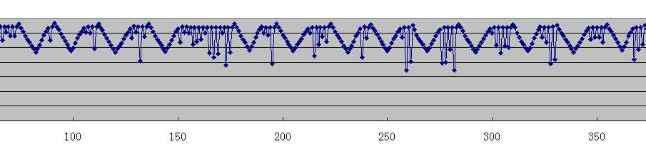
The Raw Data

Slide 4
Data Filtering
A Car Reaches a Sensor: a set of CONTINUOUS drops in reading is expected and the first drop represents the reaching time.
A Car Leaves a Sensor: A set of relatively continuous increases in reading is expected.

Slide 5
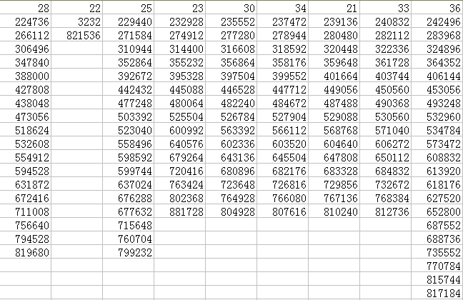
Data Analysis – Reach Time

Slide 6
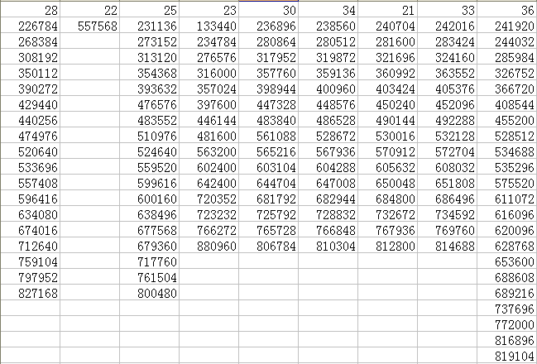
Data Analysis – Leaving Time

Slide 7
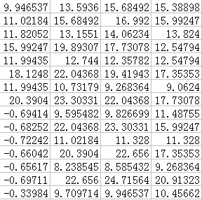
Data Analysis – Speed Calculation based on Reaching Time

Slide 8
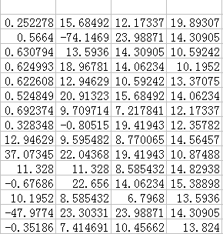
Data Analysis – Speed Calculation based on Leaving Time

Slide 9
Conclusion
From the current experiment results, it seems OK to calculate the speed based on the time stamp of the car reaching each sensor.
Speed calculation based on the time stamp of the car leaving each sensor still needs further works.
Based on my analysis, my new data filtering methods should be OK.

Slide 10
Next Experiment
Add my data filtering algorithm into the code and see how good it is.
Upon detecting the events (when a car is reaching or leaving), each sensor will forward a message to its previous sensor.
Programs are ready and I will need to work on the details of the next experiment.

Slide 11
User Authentication Program
Steven Lai

Slide 12
Pub/Sub Paradigm
Each login node is a subscriber.
Upon detection of a user, the login node will ‘subscribe’ for that user’s key.
The ‘subscription’ will be routed to sink.
Sink will ‘publish’ the required user’s key.
1 publisher V.S. n subscribers

Slide 13
Next Step (for UA) …
Add the real authentication mechanisms into the program.
Keep working on the registration phase.

Slide 14
Next Step (for Testbed / PubSub) …
Based on my works on UA, I can think about how to implement a DT Pub/Sub system with a ferry.
Key points: how to apply the PubSub paradigm to the ferry.
  Publishers will only publish until a ferry comes?
  Subscribers will keep their subscriptions and get what they want until a ferry comes?

